Slide 1
Solar Education Training

Slide 2
Overview
Solar Basics
Shopping for solar arrays
The solar experience – utility billing and maintenance
Summary and additional resources

Slide 3
Solar Basics - Definitions
Kilowatt hour – The unit used by BWL to bill residential customers, a kilowatt hour is equal to 1000 watts in one hour.
Kilowatt – a standard unit of power. Most appliances are rated in watts. For example, an LED lightbulb might have a wattage of 6W (six watts). The lightbulb would use 6Wh, or 0.006 kWh if used for 60 minutes. A 1000W window AC unit would use 1 kWh if used for 60 minutes.
  Solar arrays are rated in Kilowatts. Each panel’s individual wattage is added together for a DC kilowatt value, while inverters or microinverters have an AC kilowatt value.
Panel/Module – typically made of silicon, panels are the part of an array that actually create the energy in any array. A module is a panel with integrated wiring.
Inverter – the electrical component of a solar array that converts the DC energy produced by the panels into AC energy that can be used in your home or sent back to BWL’s grid.

Slide 4
Solar Basics – Items to Consider
Solar panels are often installed on a roof, though customers with available land may opt to install them on ground mounts.
Solar panels are rated to last 20-30 years. Customers should make sure their roof is also rated to last that long. Removing solar panels in order to do a roof replacement is a very costly ordeal and something that is not offered by many solar installers or roofing contractors.
Inverter lifespan is one of the biggest questions regarding solar systems to date. Be sure to ask your contractor what the estimated lifespan of the inverter you are planning to install is. It is possible you will have to pay to replace an inverter before your panels’ lifespan is over.
Solar arrays provide energy to the home and the grid by connecting to the home’s existing electrical service panel. Some customers may need to upgrade their existing electrical panels before a solar array can be successfully connected, which is an additional cost.
Solar arrays work when the sun shines on the panels. If panels are shaded by trees, neighboring buildings, clouds or snow, they will not function or will function less efficiently. Shading reports should be included in every bid for work, and homes that have low Total Solar Resource Factors (TSRFs) should reconsider installing an array.

Slide 5
Solar Basics – Geography of Michigan
According to the Energy Information Agency, a typical capacity factor for a solar array in Michigan is 17%. This means that of all 8760 hours in a year, a solar array will be producing 17% of the time, or about 1500 hours in a year. At all other times, customers will be drawing energy from BWL’s electric grid.
Because Michigan is in the northern hemisphere, the sun always shines in the southern part of the sky. This means that panels installed on the northern side of a tilted roof will only produce about 60% of the energy as the same panels installed on the southern side of the same tilted roof would.
  Any proposal that includes panels on the north side of the roof should be questioned thoroughly before signing a contract with that contractor.
Panels installed on the eastern or western side of a tilted roof will produce about 90% of a panel installed on the south side of the same tilted roof.
Panels covered by snow in the winter have the ability self-shed snow, though this requires a bit of sun to do. Panels covered by snow will produce no energy.

Slide 6
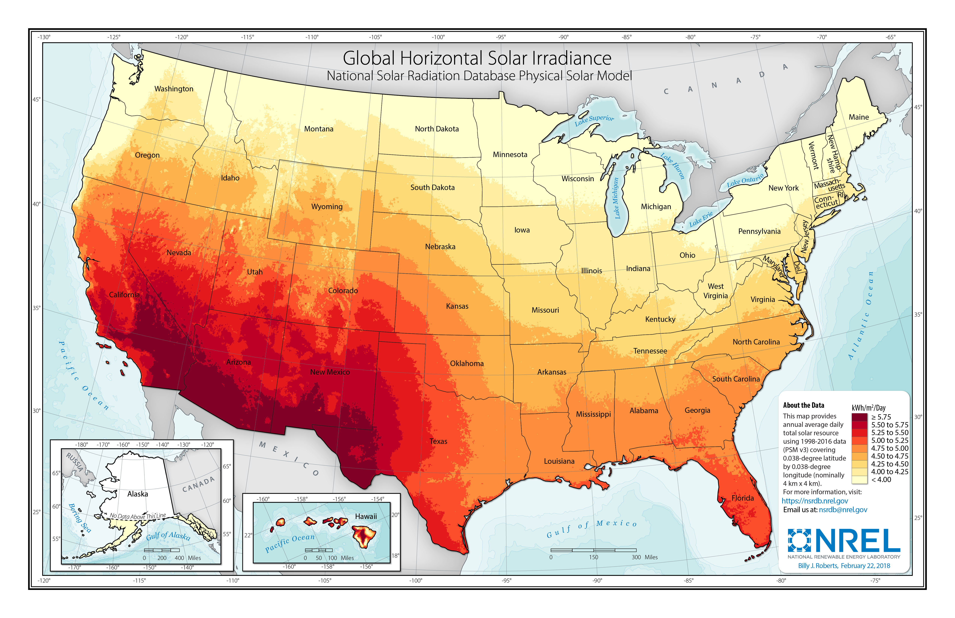
Solar arrays installed in Michigan receive less sunlight than arrays installed in most other states

Slide 7
How to Select a Contractor
Link to full PDF document on BWL’s website
Seek at least three bids from three different contractors
Beware of $0-out-of-pocket offers.
Perform an energy audit of your home first to look for ways to reduce your energy usage that may require less up front capital and/or investment.
Check for warranty information on panels and inverters
Be sure you are working with licensed and insured contractors any time you are having someone do work on or at your home.
Ask for references from a contractor for other homes in the Mid-Michigan area that they have worked with.

Slide 8
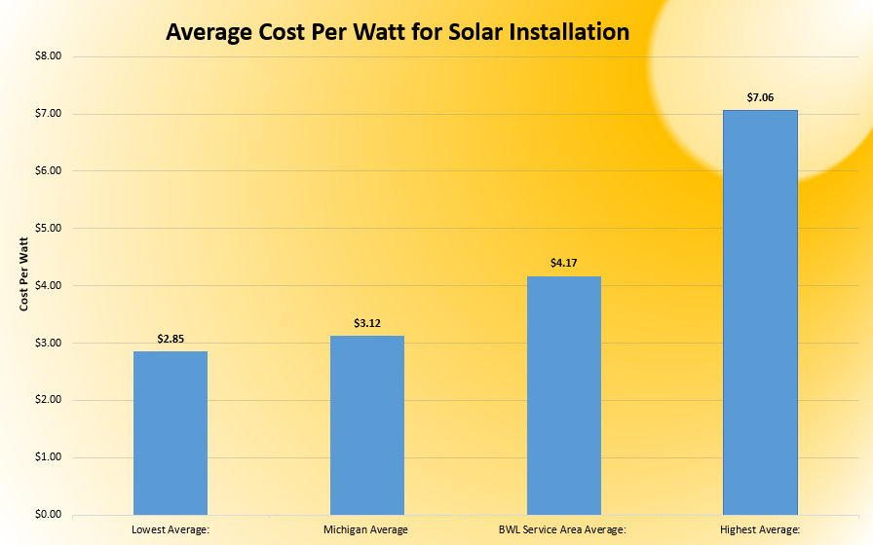
Average Solar Costs Per-Watt in BWL Service Territory
Chart shows the differences between:
  The lowest average cost from a contractor
  The highest average cost from a contractor
  The Michigan Average
  The BWL Territory Average
This chart shows that there is a wide range in prices in BWL’s Service Area.
This is why it is so important for customers to get multiple bids for their solar.

Slide 9
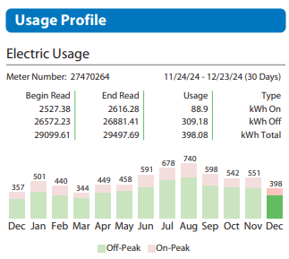
Sizing a Solar System
Customers should be aware of their annual electricity usage and how monthly changes impact their energy use.
Calculating your annual usage is as easy as counting your last twelve months of kWh usage from the graph on your BWL bill and adding it together.
Beware contractors who try and sell you systems that have an annual production that exceeds your usage by more than 125%- you could be paying for panels you don’t need
BWL will credit customers back for all energy sent back to the grid, but the credit will never be in the form of a check, only a bill credit.

Slide 10
Battery Storage and Islanding
Customers who install solar without a battery backup will be without power whenever there is a local outage.
In the event of an outage, your inverter will automatically shut off. This is in order to protect workers who are fixing the local distribution grid. Any active solar arrays during outages will be subject to penalty to BWL and customers are responsible for any injuries that occur if energy generated by a solar array during an outage injures an electrical worker or other bystander.
If you are interested in installing a battery backup system, speak with a contractor about proper sizing to ensure you can have power during an outage. Be sure to ask them for appropriately sized backup systems that can support the powering of an air conditioning unit or refrigerator/freezer.

Slide 11
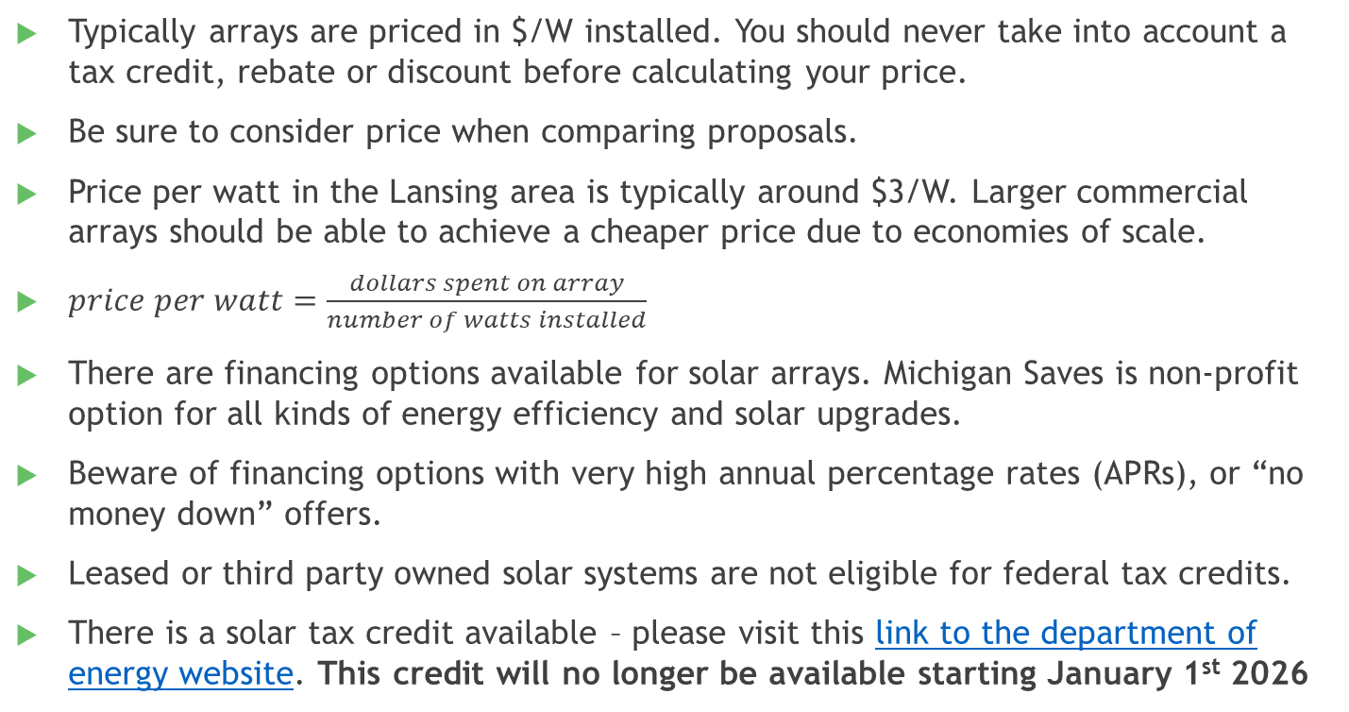
Paying for your Solar System
Typically arrays are priced in $/W installed. You should never take into account a tax credit, rebate or discount before calculating your price.
Be sure to consider price when comparing proposals.
Price per watt in the Lansing area is typically around $3/W. Larger commercial arrays should be able to achieve a cheaper price due to economies of scale.
$price per watt=\frac{dollars spent on array}{number of watts installed}$
There are financing options available for solar arrays. Michigan Saves is non-profit option for all kinds of energy efficiency and solar upgrades.
Beware of financing options with very high annual percentage rates (APRs), or “no money down” offers.
Leased or third party owned solar systems are not eligible for federal tax credits.
There is a solar tax credit available – please visit this link to the department of energy website. This credit will no longer be available starting January 1st 2026

Slide 12
Additional Items to Consider
Warranty – What is the initial warranty on the panels/inverters? If it is below 20 years, consider higher quality panels. For inverters the average warranty lifespan is only 10 years. Consider budgeting to replace your inverter after 10 years.
Extended Manufacturer Warranty – Does the panel manufacturer offer a warranty for you to buy after the panels’ initial warranty expires?
Performance at 25 years – What percentage efficiency does the manufacturer expect the panels to perform at after 25 years? If it is below 80%, consider looking at higher quality panels.
Transferability – If you buy a home with these panels already installed, do you get the new warranty? Some manufacturers will automatically transfer the warranty to a new owner, while others make you jump through hoops. Some do not offer it at all.
Company lifespan – Is the manufacturer of the solar panels you are purchasing a reputable company? Have they been in business for longer than 5 years? What kind of reviews do their panels or inverters have online?

Slide 13
BWL Solar Services
Services offered by BWL
Provide basic education and guidance for customers thinking about installing solar
Enforce program and interconnection rules
Offer rebate and a market-based rate for energy buy-back
Provide a monthly bill for each solar customer
Services not offered by BWL
Install solar systems
Sell solar panels or inverters
Provide maintenance on solar systems
Activate solar systems

Slide 14
The solar installation process
Step 1 – Make your home as energy efficient as possible, as usage impacts payback for an array.
Step 2 – Take BWL’s solar online education class – (Not required, but highly recommended)
Step 3 – Get at least 3 bids from contractors – compare prices and contractor quality
Step 4 – contractor submits documents to BWL, BWL approves application for install
Step 5 – contractor constructs array, schedules permit inspections with local authorities
Step 6 – BWL starts billing, tests disconnect, provides contract, and notice to contractor to energize array.

Slide 15
BWL Billing For Solar Systems
All customers installing an array will be entered into BWL’s distributed generation (DG) program that pays customers a variable, market rate for energy sent back to BWL.
Customers can reduce their bills by using energy from their own solar arrays during the time that the arrays are producing energy- energy sent back to the grid receives the variable, market rate in the form of a bill credit
Customers will always send back less energy to BWL’s grid than their array produces overall because their house or building will always be using some energy that comes from the solar array.
Customers who want to perfectly calculate a payback from a solar array would have to have a 100% accurate picture of their own usage and production from their solar array for each hour of the day.
The value for energy returned to BWL is set at a fixed rate. This means that customers will be able to expect a certain price per Kilowatt Hour regardless of the time of year.

Slide 16
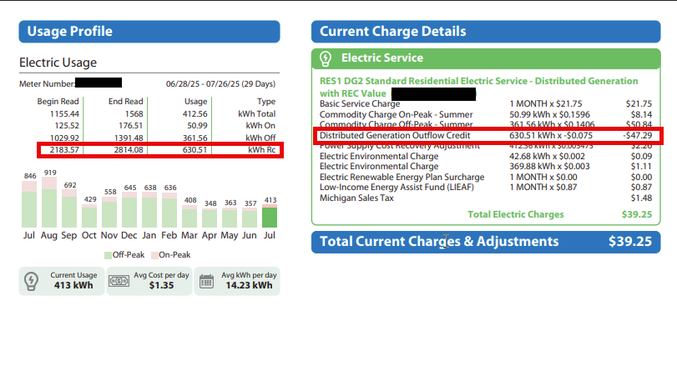
Distributed Generation Billing Example

Slide 17
Market Rate Credit for Distributed Generation
BWL will not be offering net metering to arrays activated after 11/01/2022.
There are three parts that comprise the total price that BWL will pay its solar customers for the energy they send back to the grid.
  Average Cost of Energy: This value was calculated based on the peak average cost of energy between 2021-2023 when customer’s solar panels are most likely to be generating electricity and exporting to the grid. The LMP is equal to the average on-peak (the average price for hours 8-23, Monday through Friday, excluding national holidays) LMP for the billing month (the month you’re being billed for)
    This value will be $0.050/kWh
  Capacity Credit Average: This value is calculated by importing the per-kWh value for a capacity credit from the Midcontinent Independent System Operator (MISO) for 2021-2023.
    This value will be $0.012/kWh
  Optional Renewable Energy Credit Purchase – BWL will buy the official renewable attributes for your system and enter them in the State of Michigan database to use your solar system to achieve our sustainability goals.
    BWL will pay $0.013/kWh for customers who choose to sell their RECs back to BWL.

Slide 18
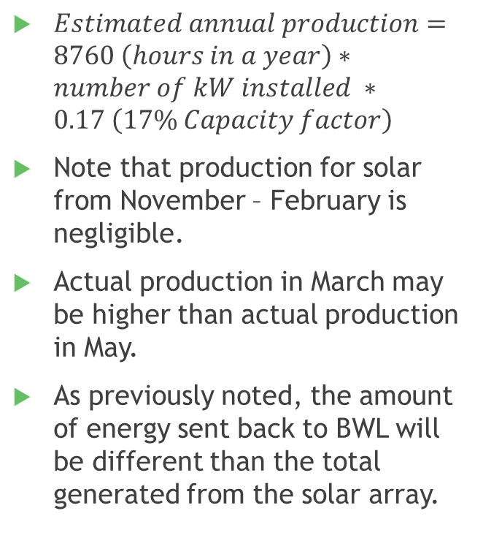
Solar Production
$Estimated annual production=8760 \left(hours in a year\right)∗number of kW installed ∗0.17 \left(17\% Capacity factor\right)$
Note that production for solar from November – February is negligible.
Actual production in March may be higher than actual production in May.
As previously noted, the amount of energy sent back to BWL will be different than the total generated from the solar array.

Slide 19
Solar Maintenance
Parallel Operating Agreements – Your parallel operating agreement is a legally binding document that you agree to with BWL. Please print and save a copy of the agreement.
Tree Trimming – Be sure to trim back any trees that might shade your solar array.
Snow – Snow reduces solar production to zero. Most panels will self heat even in cold weather when the sun shines. Be careful when trying to remove snow from rooftop systems as a mass of falling snow likely contains ice as well, and can cause serious injury if striking someone when it is removed.
Monitoring – most contractors provide a monitoring software to track production from your solar array. Be sure they install it,and be sure to check your system’s production from time to time to verify it is producing energy.
Wiring – be sure to inspect your system’s wiring from time to time. Squirrels and birds are a major nuisance to electrical systems in Michigan.

Slide 20
Summary and Important Notes
Please be sure to get at least three bids from licensed contractors or electricians before signing a contract or financing agreement.
Make sure the roof of your home or property is not shaded and is un-obstructed to the southern sky.
Ask about warranties and on-going maintenance needs for the equipment you are purchasing.
Be aware you still need to pay BWL for your electric bill.
Be aware that you will still use electricity from BWL during the 83% of the hours of the year that your array won’t be producing energy.
Be aware that if you have water, sewer, steam or chilled water service with BWL that you will still be responsible for those utility costs.

Slide 21
Next Steps
Test your knowledge by completing the online quiz associated with this educational material on BWL’s website
  https://www.lbwl.com/installsolar - link to solar quiz
Select a contractor who you wish to work with for your solar installation. They will fill out the interconnection application for you which will be reviewed by BWL.
Once the project has been given approval for interconnection, you can proceed with the installation.
Once the installation is complete, have your contractor schedule a code inspection with the local government inspector.
The contractor will submit inspection information to BWL, which will initiate your meter swap and enroll you in our Distributed Generation program.
Once the above meter and rate change is completed, you will receive an agreement from BWL. Once signed, the process is complete, and you will have permission to operate your solar system.

Slide 22
BWL’s commitment to sustainability
Energy Efficiency
  BWL strongly recommends making a home as efficient as possible before installing solar. We offer energy efficiency programs to assist customers with upgrades of lighting and appliances that can reduce the size of the solar array you need overall – link to energy efficiency programs.
Solar Rebate
  After you install your array and have received permission to operate in writing from BWL, be sure to apply for BWL’s solar rebate – link to solar rebate form.
Electric Vehicles
  BWL also offers a rebate and time of use rate for those who have purchased an electric vehicle. For more information on incentives and to find a list of local installers for level 2 chargers, visit our Plug-in EV webpage.
GreenWise Renewable Energy Purchasing
  If you discover that installing solar at your home or business isn’t quite right for you, BWL offers customers the chance to source their energy directly from Michigan-based renewable energy sources. For more information, visit our GreenWise webpage.

